Slide 1
Vulnerabilities in Open-Source Language Servers
Henry Post Intro to OS – New York University

Slide 2
Problem and motivating example
Open-source software (OSS) is everywhere! We use it all the time without knowing
When performing software development, devs use IDEs (code editors)
These code editors use software called “Language Servers” to make coding easier
Automated code testing (SAST, DAST, SCA) is not always used on OSS
Because language servers are so critical to software development, they could be vulnerable, and any vulnerabilities would present in many developers’ workflows

Slide 3
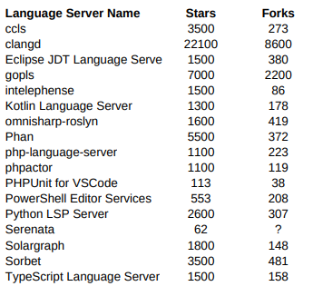
Hypothesis
Language servers are very widely used and contributed to
Because of this, they may have a large number of unknown security vulnerabilities

Slide 4
Related research: Stealthily adding flaws
This paper outlines (and the author actually does this in a real OSS project) how an attacker could, over the course of multiple different commits, introduce a vulnerability into OSS
This shows how, while OSS ecosystems are extremely powerful and useful for different reasons, they can still be manipulated and exploited
[1] Wu, Qiushi and Kangjie Lu. “On the Feasibility of Stealthily Introducing Vulnerabilities in Open-Source Software via Hypocrite Commits.” (2021).
Notes:
* It’s for this reason that we should be scanning OSS for vulnerabilities: Bad actors could be doing this to any OSS, anywhere, at any time. This paper is a practical guide on how to poison OSS with vulnerabilities in a way that its maintainers may not notice.

Slide 5
Related research: Vulnerability metadata
This paper describes a system for attaching context to an identified vulnerability that affects an OSS component, in order to understand if it is actually exploitable, given the context in which the OSS component is used by a software application.
This is a useful paper because some vulnerabilities identified by SCA (Software Composition Analysis) tools are actually not exploitable depending on how the OSS components are used
I didn’t use this paper in my paper, but its methods and conclusions would be useful to reduce SCA noise.
[3] H. Plate, S. E. Ponta and A. Sabetta, "Impact assessment for vulnerabilities in open-source software libraries," 2015 IEEE International Conference on Software Maintenance and Evolution (ICSME), Bremen, Germany, 2015, pp. 411-420, doi: 10.1109/ICSM.2015.7332492.

Slide 6
Findings: Overview
17 different language servers were chosen, all vary in star count, fork count, and language.
Almost all had some SAST and SCA vulnerabilities.
Some had invalid findings, since test code got scanned
Scanning tools used:
Snyk SCA
Snyk SAST
SonarQube SAST

Slide 7
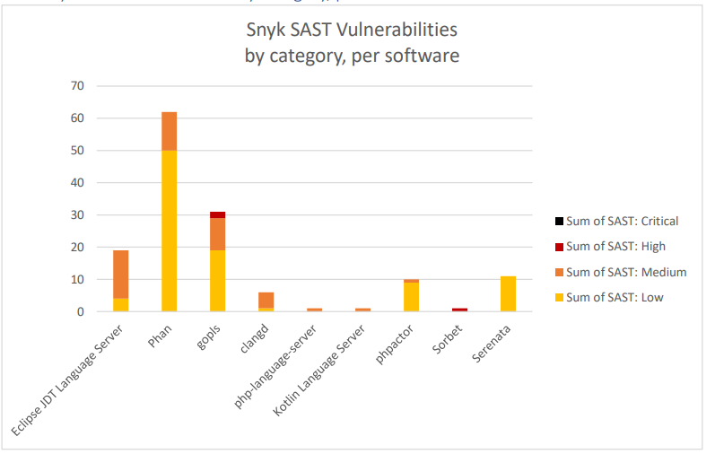
Findings: Snyk SAST
Notes:
Here we can see that there are a decent amount of Medium, High vulnerabilities across 9 projects from Snyk’s SAST scanner.

Slide 8
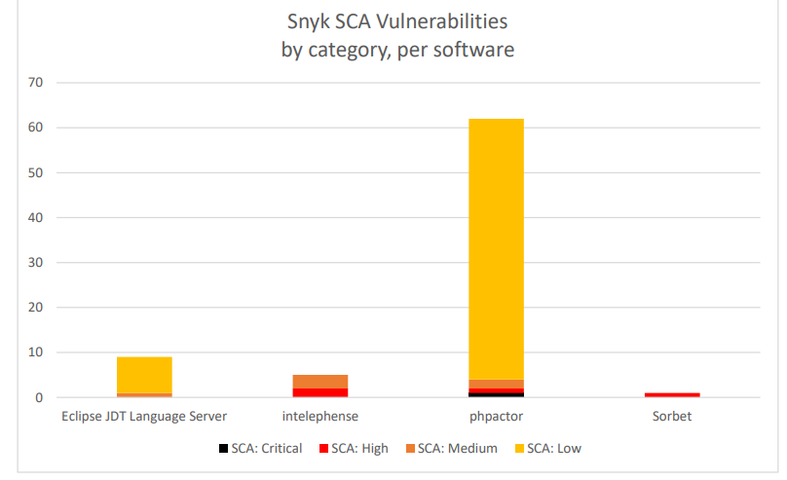
Findings: Snyk SCA
Notes:
And here are some SCA vulnerabilities from Snyk. There’s fewer, but there’s still a decent amount.

Slide 9
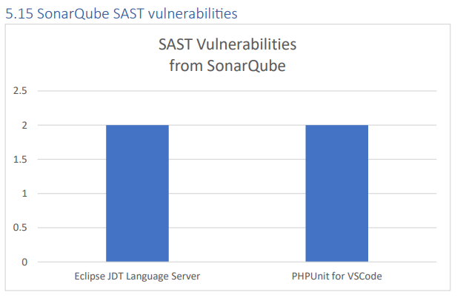
Findings: SonarQube SAST Vulnerabilities
Notes:
These are SAST vulnerabilities from SonarQube. There’s not a lot of them.

Slide 10
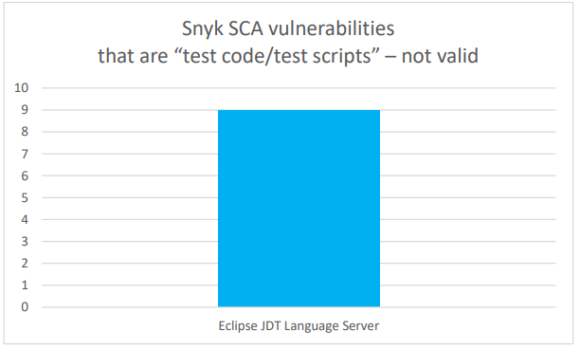
Findings: Test code that shouldn’t be scanned: Snyk SCA
Notes:
For these graphs, I manually went through each finding and determined if it was produced because of test code or scripts that got scanned.

Slide 11
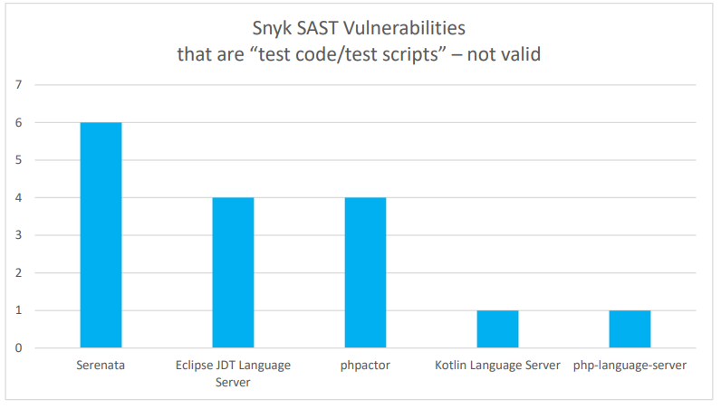
Findings: Test code that shouldn’t be scanned: Snyk SAST
Notes:
For these graphs, I manually went through each finding and determined if it was produced because of test code or scripts that got scanned.

Slide 12
Findings: Conclusions
Many open-source projects (not just language servers) might have numerous high-severity vulnerabilities that their authors have no idea about
9 projects have valid Snyk SAST vulnerabilities, 4 projects w/ valid Snyk SCA vulnerabilities, and 2 projects with SonarQube SAST vulnerabilities
Those “test code” findings waste time – We need to automate their removal!
11.2% SAST and 11.6% SCA findings only showed up because of test code getting scanned
Notes:
16 SAST vulnerabilities and 9 SCA vulnerabilities only showed up because test code got scanned. Out of the 142 SAST vulnerabilities and 77 SCA vulnerabilities, this represents a non-negligible “test code that got scanned but shouldn’t have been” metric: (16/142) or 11.2% for SAST, and (9/77) or 11.6% for SCA.
The metrics support my hypothesis. There are 9 projects with valid Snyk SAST vulnerabilities, 4 projects with valid Snyk SCA vulnerabilities, and 2 projects with valid SonarQube SAST vulnerabilities. Of these projects, 5 have at least 10 SAST vulnerabilities. These are non-negligible vulnerability reports, and it makes me feel that this method of testing open-source language servers should be automated in some way

Slide 13
Next Steps
Automate my work and expand this to 1000’s of repositories on GitHub?
Can be done easily with shell scripts and the Snyk REST API
An automated system for evaluating the security posture of any open-source software project
A “software security health” scorecard system that can be used to give a score to open-source software projects
An AI-powered system that can evaluate open-source software projects for potential security issues based on code patterns and open-source contributor behaviors
Examine how various projects use security checks within their CI/CD pipelines
A thorough review and comparison of various SAST and SCA tools, to determine which ones offer the most comprehensive and accurate results

